Slide 1
RNA-seq Challenge
Andy Tran

Slide 2
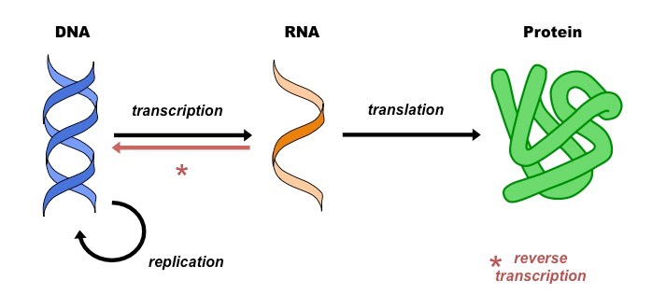
Background – The Central Dogma of Biology
Measuring RNA gives us an insight into the biological mechanisms in a tissue/cell.

Slide 3
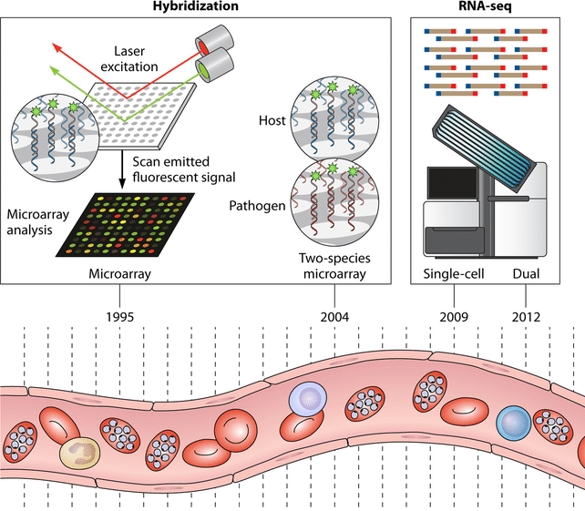
Background – RNA sequencing technology
Many technologies can be used to measure the amount of RNA in a tissue/cell
More modern technologies:
Single-cell
Single cell multiomics
Spatial transcriptomics
Any many more!

Slide 4
Research questions
Which genes are differentially expressed between two conditions?
For example:
Disease vs healthy
Treatment vs control
Early/late developmental stages
Early/late disease progression
Which biological functions/pathways are different between two conditions?

Slide 5
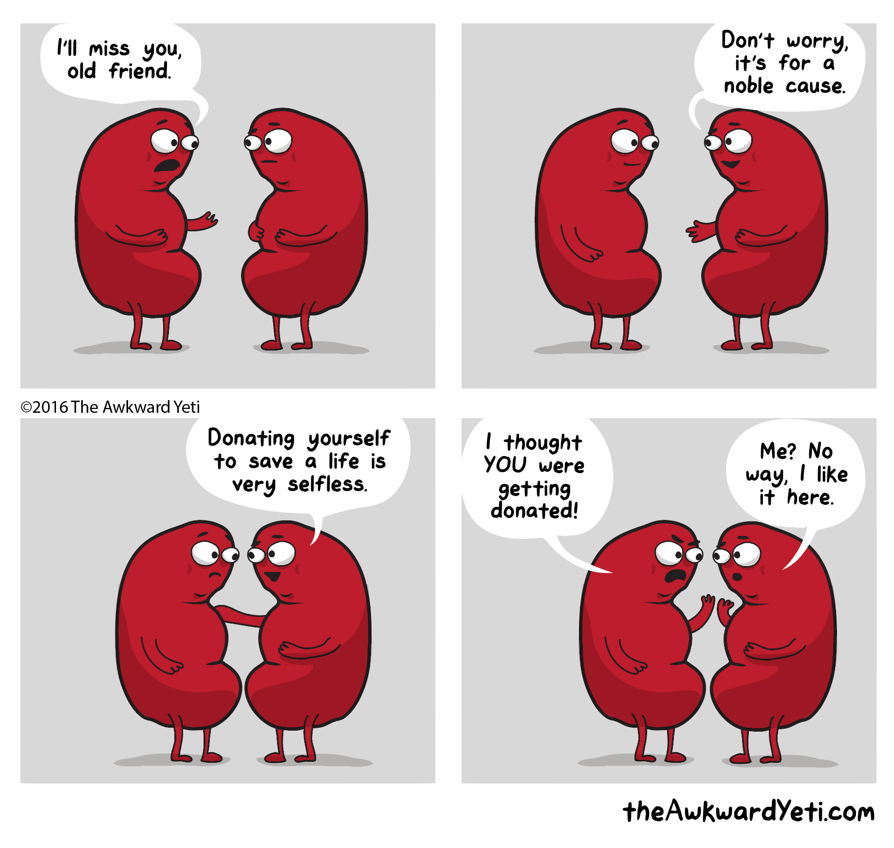
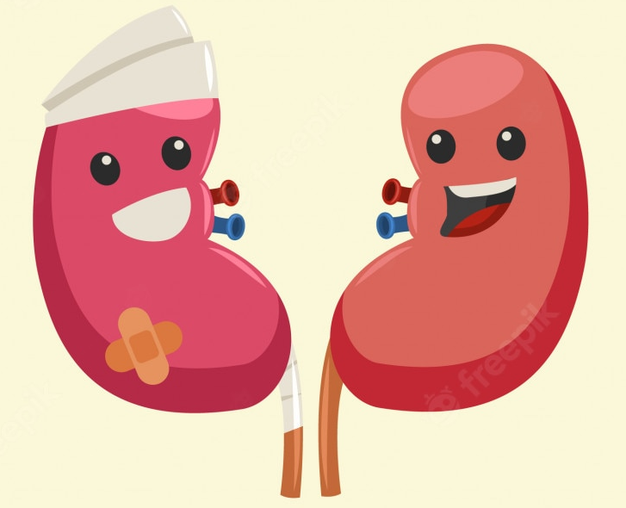
Data Challenge
Kidney transplantation is the treatment of choice for people with end-stage kidney disease.
Many patients will develop graft rejection after kidney transplant.
Understanding the causes and drivers of graft rejection will improve patient outcomes.

Slide 6
Data Introduction
Data is sourced from Gunther et al. and Yi et al.
Data has been pre-processed and normalised.
Further filtering or processing may be helpful.
exprs_mat.csv contains the gene expression data
Rows represent genes, columns represent kidney transplant recipients
Read into R using exprs_mat <- read.csv("exprs_mat.csv",row.names=1)
outcome_mat.csv contains the patient outcomes
The first column contains the patient IDs
The second column contains the outcomes:
AR = acute rejection
non-AR = no acute rejection
Read into R using outcome_data <- read.csv("outcome_mat.csv")

Slide 7


Analytical software
Fortunately, there is plenty of analytical software that has been developed
Unfortunately, there is plenty of analytical software that has been developed

Slide 8



Differential Expression Analysis
Quantifies how differentially expressed each gene is between two conditions.
Generally uses a statistical test to standardise across genes and estimate significance.
Popular packages include: limma, edgeR and DESeq2.

Slide 9
DE Analysis: Suggested code
design <- model.matrix(~ classes)
limma.fit <- lmFit(exprs_mat, design)
limma.fit <- eBayes(limma.fit)
DEresults <- topTable(limma.fit, number = Inf, sort.by = "p")
datatable(DEresults)
Line 1: “classes” indicates the two conditions. model.matrix creates a matrix that tells limma which samples belong to which class.
Line 2: lmFit fits a linear model (equivalent to a t-test).
Line 3: eBayes calculates moderated t-statistics.
Line 4: topTable selects the top DE results and sorts them.
Line 5: datatable displays the results in a user-friendly table (requires package DT)

Slide 10
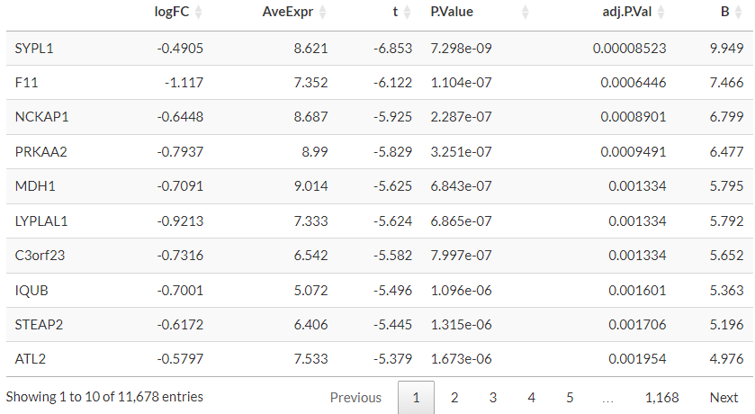
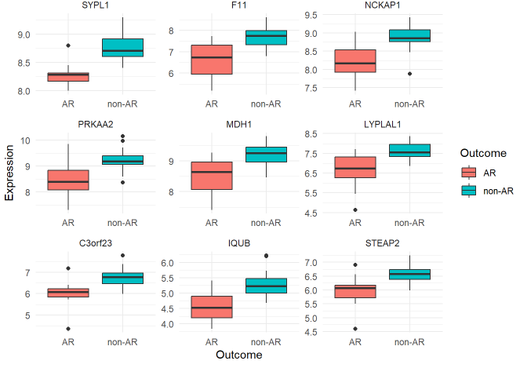
DE Analysis: Example
Gene
symbol
Log fold change
Average
Expression
Test
statistic
P value
Adjusted
P value
B statistic
Visualisation using ggplot (code not provided)

Slide 11
Gene Set Testing + Enrichment Analysis
From a DE analysis, which pathways (gene sets) are different between the two conditions?
Many databases of functional gene sets:
Gene Ontology (GO): cellular component, molecular function, biological process
Kyoto Encyclopedia of Genes and Genomes (KEGG)
Generally two main types of approaches:
Overrepresentation (similar to chi-squared test)
Enrichment (similar to Wilcoxon rank-sum test)
Popular packages include: clusterProfiler, gage, gsva, fgsea

Slide 12
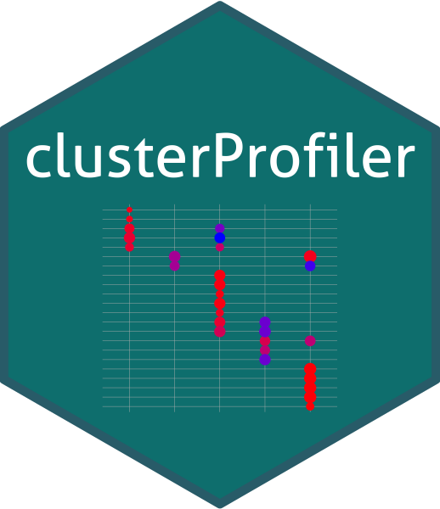
GSEA Analysis: Suggested code
gene_list <- -log10(DEresults$P.Value)
names(gene_list) <- rownames(DEresults)
gse <- gseGO(geneList=gene_list,
ont ="BP",
keyType = "SYMBOL",
OrgDb = org.Hs.eg.db)
datatable(gse@result)
Line 1: creates an ordered list of genes by differential expression and stores it in gene_list.
Line 2: names each element in gene_list by the gene symbol (a requirement for gseGO)
Line 3: gseGO performs the GSEA analysis. ont specifies the database to use (bp = biological process). keyType specifies the naming convention of the genes. OrgDb specifies the organism database (org.Hs.eg.db is for human)
Final line: outputs the result in a user friendly table. (requires package DT)

Slide 13
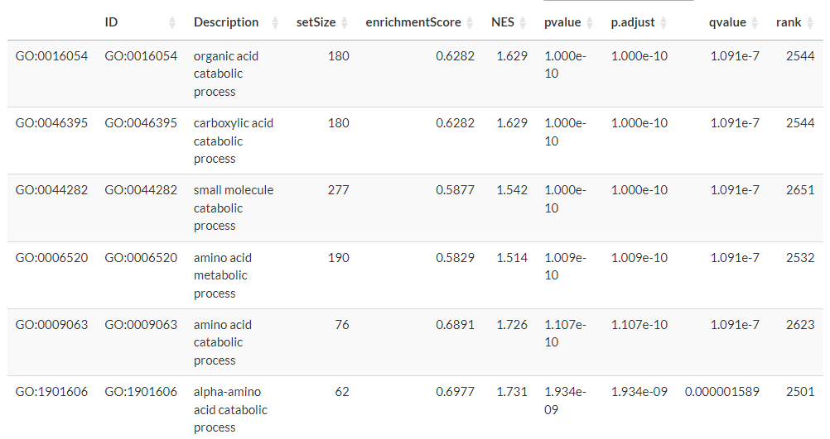
GSEA Analysis: Example
Pathway ID
Pathway Description
Pathway size
Enrichment Score
Normalised Enrichment score
P value
Adjusted
P value
Q-value
(FDR)
Rank of max enrichment

Slide 14
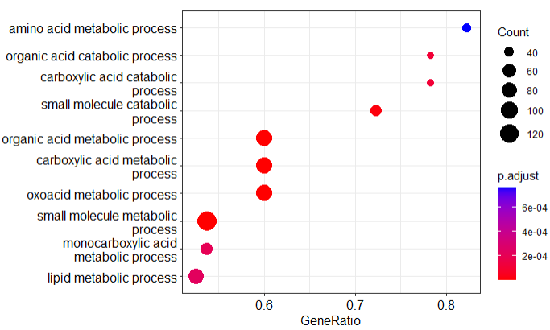
GSEA Analysis: Visualisation
Dotplot visualises the top terms with the size, adjusted p-value and gene ratio
dotplot(gse)

Slide 15
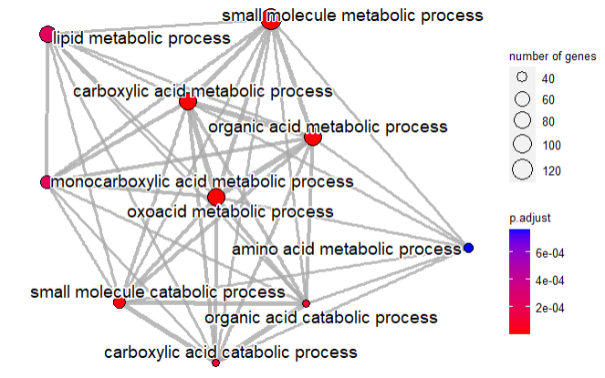
GSEA Analysis: Visualisation
Network plot visualises overlap and similarity between top terms
gse <- pairwise_termsim(gse)
emapplot(gse, showCategory = 10)

Slide 16
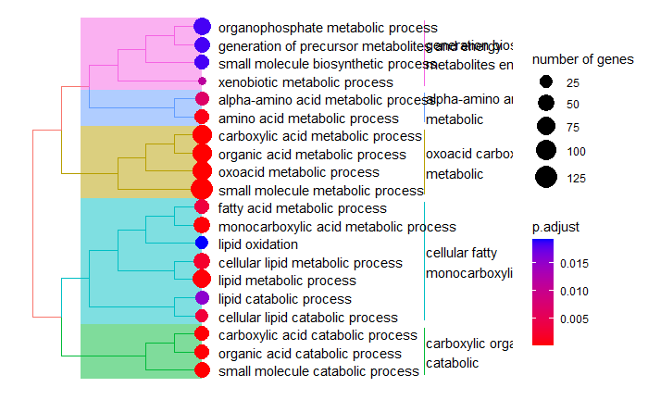
GSEA Analysis: Visualisation
Tree plot groups terms based on similarity
treeplot(gse)

Slide 17
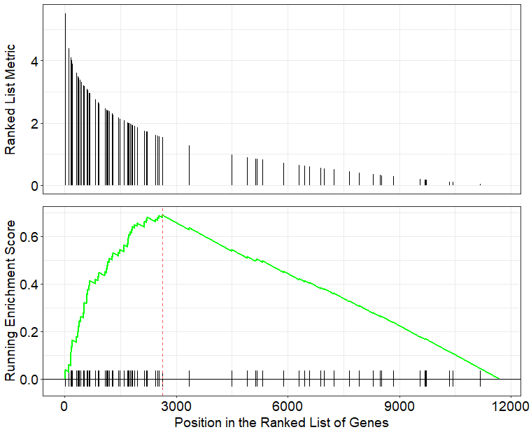
GSEA Analysis: Visualisation
Enrichment plot shows the GSEA result for an individual pathway
gseaplot(gse, path.id)

Slide 18
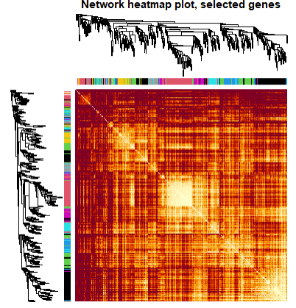
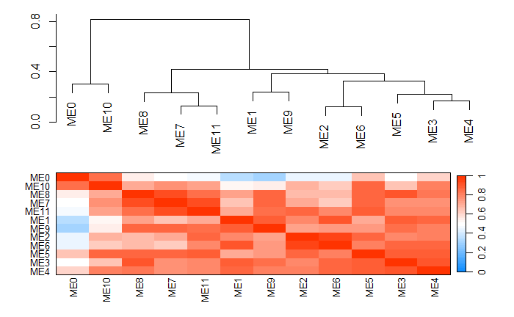
Advanced: WGCNA
Weighted Gene Coexpression Network Analysis
Analyses the relationship between genes in the data set: identifies modules of genes, and key genes.
All functions implemented in wgcna package.

Slide 19
Extension
You may want to combine the results of the two data sets (but be aware that the data comes from different tissues).
You are welcome to search for additional data sets. A suggestion is to browse the Gene Expression Omnibus.

Slide 20
Installing Packages
Install the required packages by running the following code in the terminal:
install.packages("BiocManager")
BiocManager::install(c("tidyverse", "plotly", "DT", "limma", "clusterProfiler", "org.Hs.eg.db", "enrichplot", "WGCNA"))
Load the packages in your R/rmd/qmd file with the following code:
library(tidyverse)
library(plotly)
library(DT)
library(limma)
library(clusterProfiler)
library(org.Hs.eg.db)
library(enrichplot)
library(WGCNA)

Slide 21
Additional Resources
Transcriptomics analysis workflow
Clusterprofiler tutorial
WGCNA tutorials

